Slide 1
Arts, Commerce and Science College, Maregaon Dist.-Yavatmal 445304 (M.S) Department Of Physical Education

Slide 2
Vision in Physical Education Department
Strive for "MASS PARTICIPATION" of your in Games and Sports (Physical Activities) to develop Personal Health, Fitness and Social qualities which will enable them to become worthy citizens of India and in Process endeavor to produce National and International level players.

Slide 3
Mission
“Games and Sports are the important dimensions of quality of an Institution of Higher Learning”.
Let the youth realize that “Body is the medium of all the End eavours”. Body should be strong to achieve heights in any sphere of life.
To make youth aware of the importance of Games and Sports (Physical Activities) in the overall development i.e. Physical, Mental, Social and Spiritual.
To strive for quality Education in keeping with the motto of the college, “Excellence in Education ”and prepare young minds for imbibing knowledge, skills and sensitivity.

Slide 4
Aim and Objective of Physical Education
• To keep the students active and free-minded.
• To help maintain a healthy life.
• To develop the body agile and flexible.
• To grow a sportsperson's spirit within.
• To develop movement proficiency.
• To have a proper appetite and sound sleep.
• To concentrate on studies.
• To develop motor skills.

Slide 5
Vision for the college
Every child will...
• be afforded the opportunity to engage in worthwhile and meaningful activities which promote active and healthy lifestyles in Pre-K through Grade 12.
• participate in fitness assessments that provide valuable reflection of past and current ability levels in addition to serving as the basis for determining future potential.
learn how to make healthy choices as they relate to the total health of one’s own body.
• cultivate an appreciation for the importance of creative movement as it relates to everyday living.
• exhibit, and have modeled for him or her, good sportsmanship/etiquette on and off the playing field.
• learn to be a spectator, and to see the value our culture places on sport performance.

Slide 6
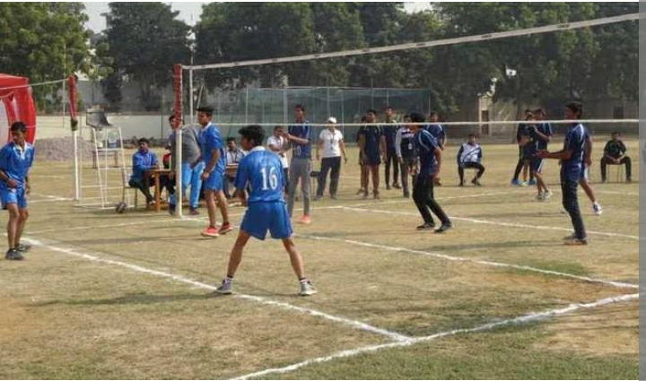
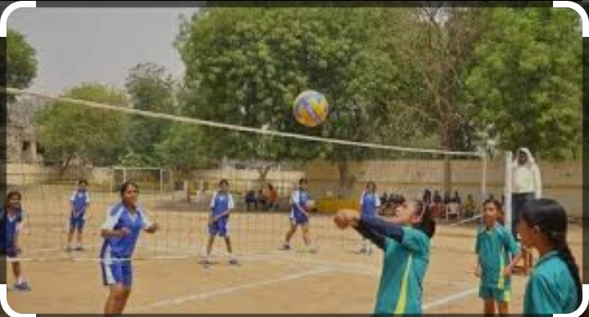
Arts, Commerce and Science College, Maregaon Physical Education Departmental Report : 2016 To 2017 Sport Activity 2016 To 2022 Inter Collegiate Tournament
Boys Volleyball Inter Collegiate Tournament
Girls Volleyball Inter Collegiate Tournament

Slide 7
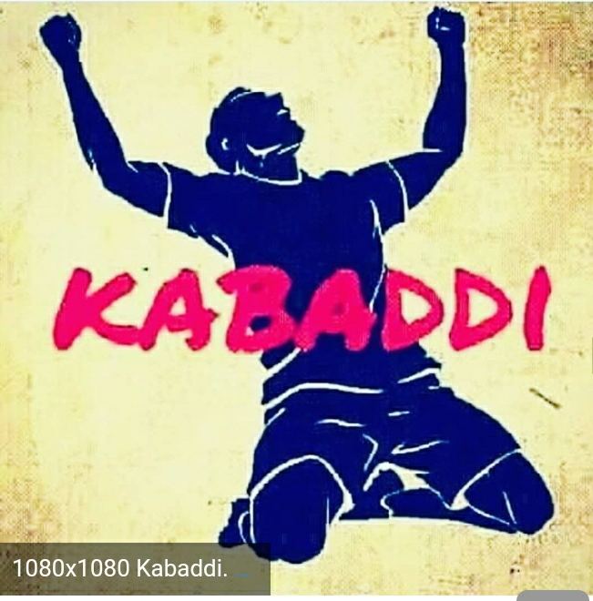
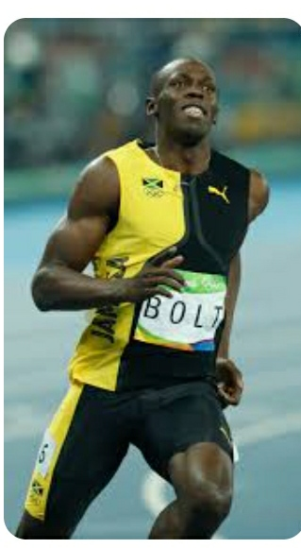
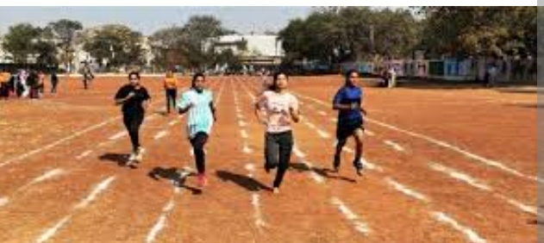
Boys Kabaddi Inter Collegiate Tournament
Girls Raining Inter Collegiate Tournament

Slide 8
Arts, Commerce and Science College, Maregaon Physical Education Departmental Report : 2017To 2018 Sport Activity 2016 To 2022 Inter Collegiate Tournament
Girls Volleyball Inter Collegiate Tournament
2016 To 2017

Slide 9
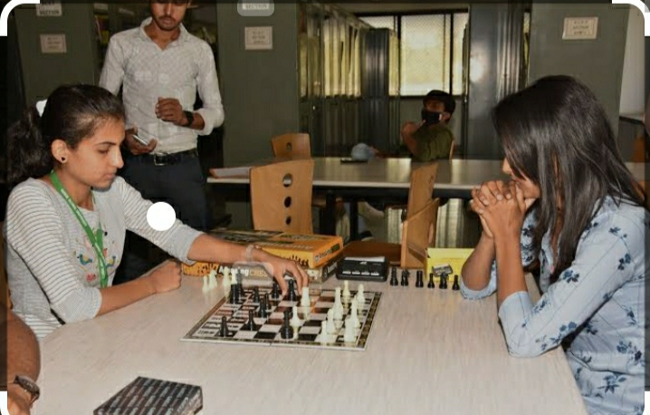
Boys Kabaddi Inter Collegiate Tournament
Girls chess Inter Collegiate Tournament

Slide 10
Arts, Commerce and Science College, Maregaon Physical Education Departmental Report : 2018To 2019 Sport Activity 2016 To 2022 Inter Collegiate Tournament

Slide 11
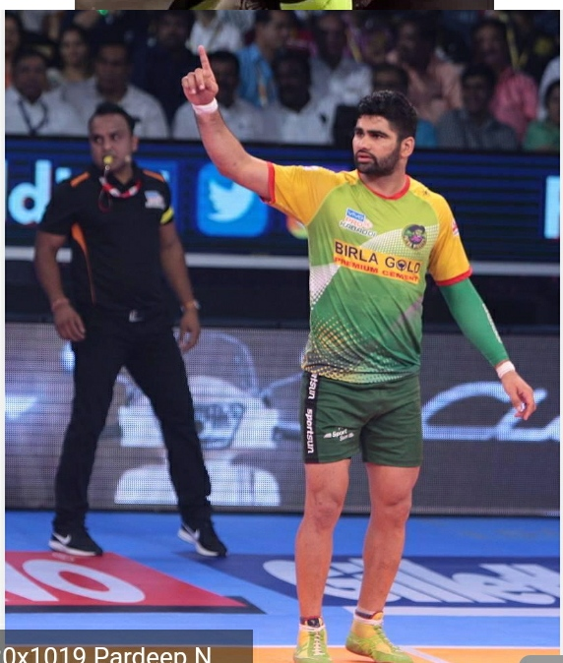
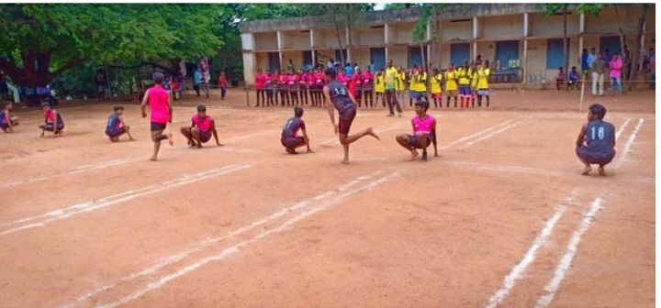
Boys Kabaddi Inter Collegiate Tournament
Boys Kho-Kho Inter Collegiate Tournament

Slide 12
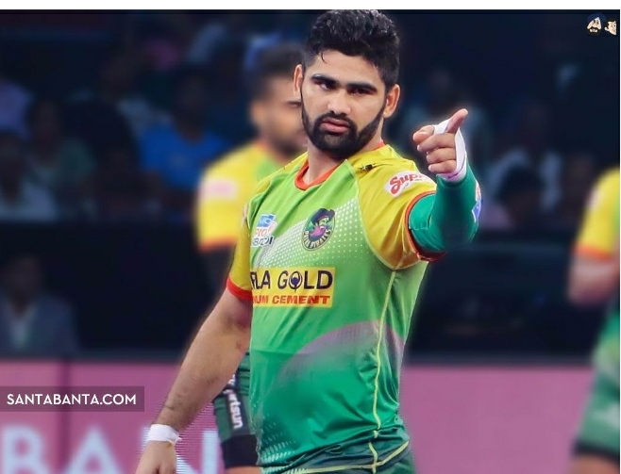
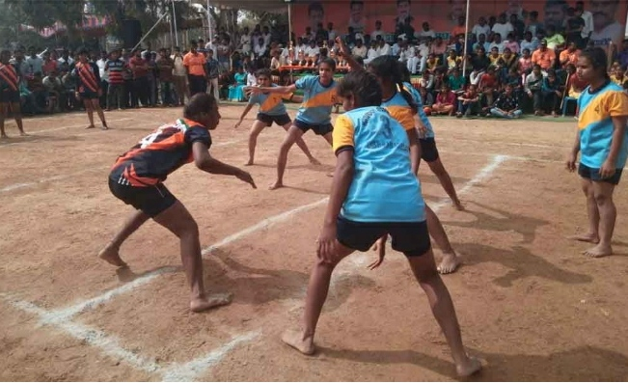
Arts, Commerce and Science College, Maregaon Physical Education Departmental Report : 2019To 2020 Sport Activity 2016 To 2022 Inter Collegiate Tournament
Boys Volleyball Inter Collegiate Tournament
Girls Kabaddi Inter Collegiate Tournament

Slide 13
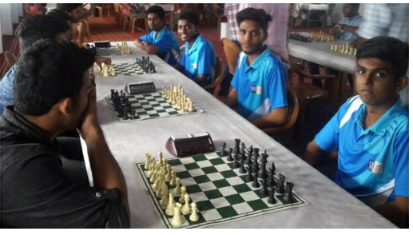
Girls Kho- Kho Inter Collegiate Tournament
Boys chess Inter Collegiate Tournament

Slide 14
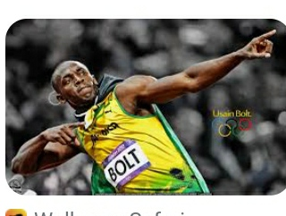
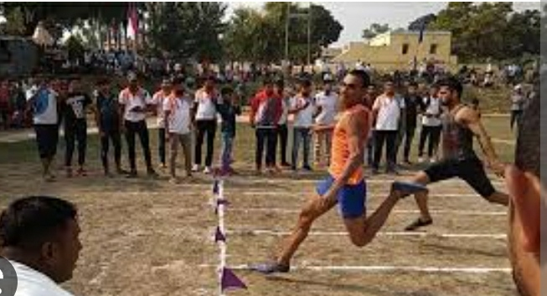
Boys Raining Inter Collegiate Tournament

Slide 15
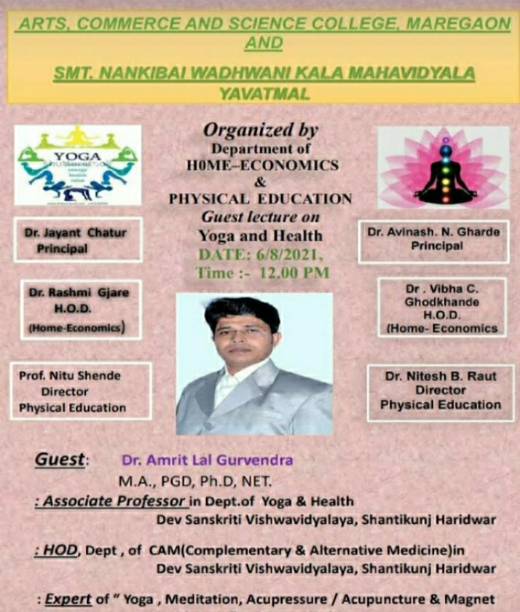
Arts, Commerce and Science College, Maregaon Physical Education Departmental Report : 2021To 2022 Inter Collegiate Tournament
GUEST LECTURE FOR YOGA & HEALTH
GUEST Dr. Amrit Lal Gurvend

Slide 16
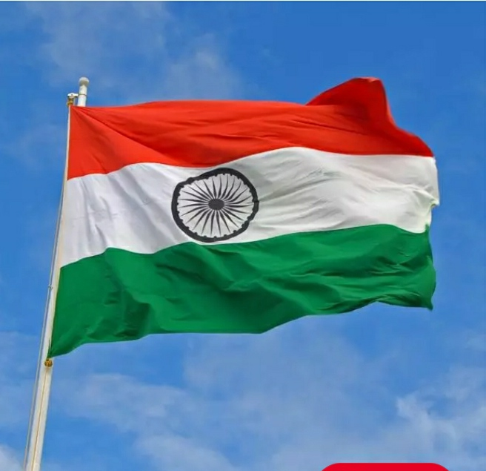
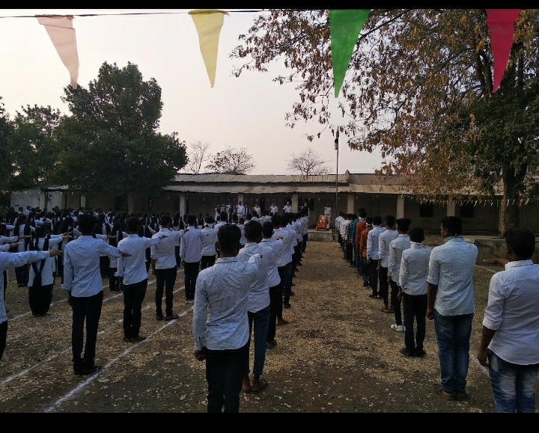
15 August Independence Day 2021-2022
26 January Republic Day 2021- 2022

Slide 17
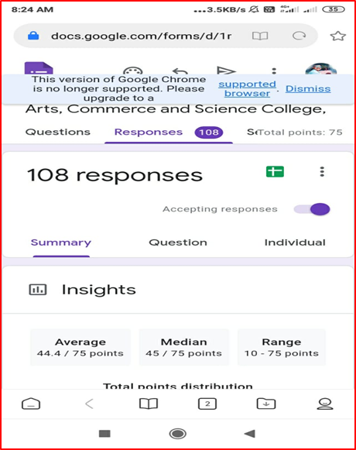
29 August National Sports Day
26 November Constitution Day 2021-2022
Google Meet Sports Day Quiz 2021-2022

Slide 18
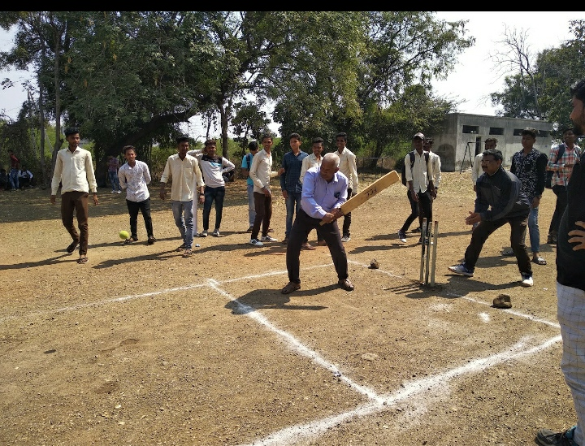
Blood Donet Camp
Organize Intra-college competitions

Slide 19
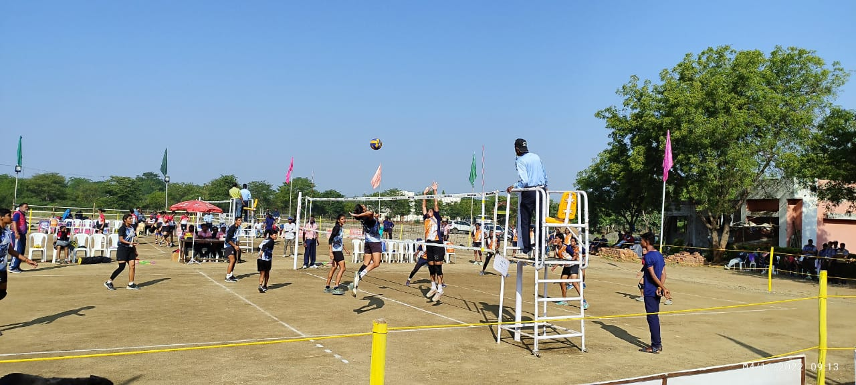
Inter Collegiate Kabaddi Trail Camp
Inter Collegiate Volleyball Trail Camp

